Slide 1

Bfs algorithm
Breadth-first search algorithm
by Lorenzo de Simone

Slide 2
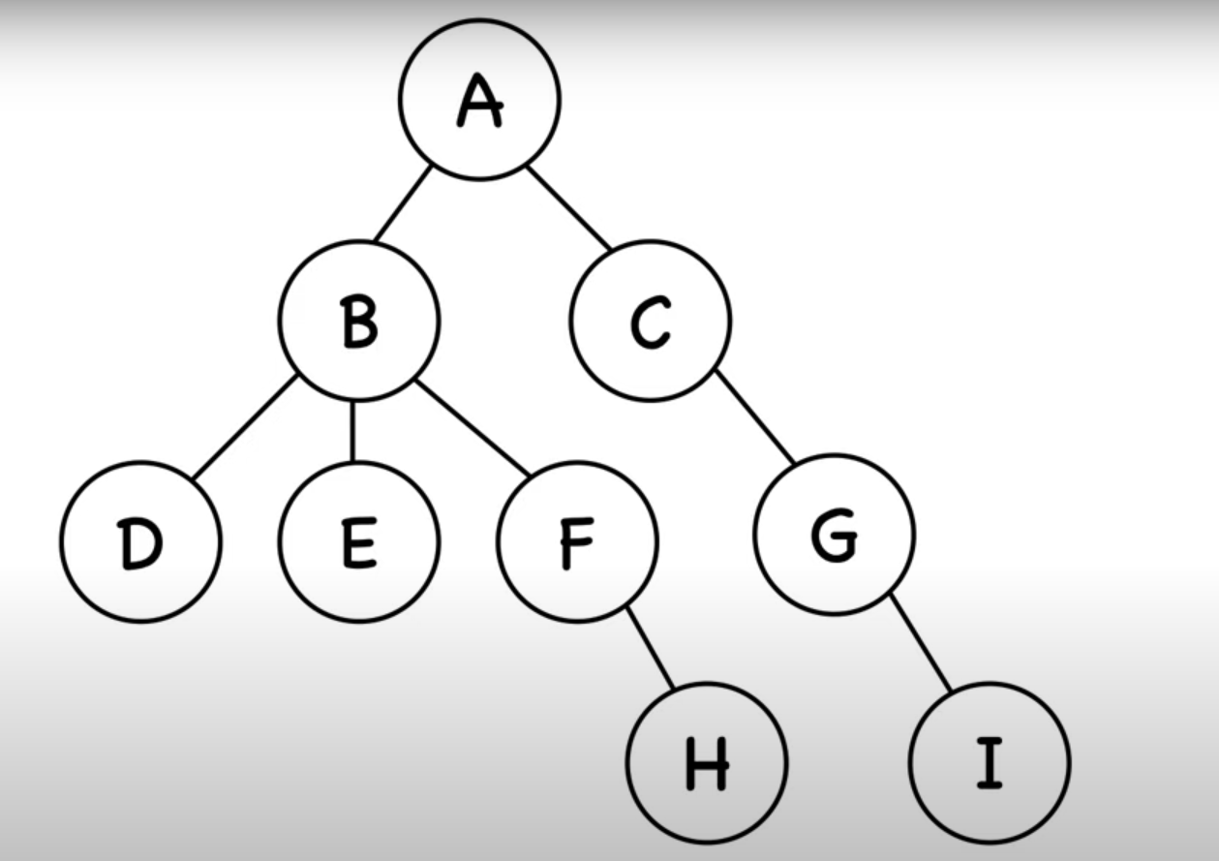



How the sequential program works:
Check the following elements of the current frontier element
Add to new frontier
Repeat the check with the next elements in the current frontier
Repeat previous steps with the new frontier
Element already checked
Current frontier
Checked element
New frontier=[]

Slide 3

How the sequential program works:
Check the following elements of the current frontier element
Add to new frontier
Repeat the check with the next elements in the current frontier
Repeat previous steps with the new frontier
Element already checked
Current frontier
Checked element
New frontier=[]

Slide 4
How the sequential program works:
Check the following elements of the current frontier element
Add to new frontier
Repeat the check with the next elements in the current frontier
Repeat previous steps with the new frontier
Element already checked
Current frontier
Checked element
New frontier=[D]

Slide 5

How the sequential program works:
Check the following elements of the current frontier element
Add to new frontier
Repeat the check with the next elements in the current frontier
Repeat previous steps with the new frontier
Element already checked
Current frontier
Checked element
New frontier=[D,E]

Slide 6

How the sequential program works:
Check the following elements of the current frontier element
Add to new frontier
Repeat the check with the next elements in the current frontier
Repeat previous steps with the new frontier
x2
Element already checked
Current frontier
Checked element
New frontier=[D,E,F]

Slide 7

How the sequential program works:
Check the following elements of the current frontier element
Add to new frontier
Repeat the check with the next elements in the current frontier
Repeat previous steps with the new frontier
x3
Element already checked
Current frontier
Checked element
New frontier=[D,E,F,G]

Slide 8



How the sequential program works:
Check the following elements of the current frontier element
Add to new frontier
Repeat previous steps with the new frontier
Repeat the check with the next elements in the current frontier
Element already checked
Current frontier
Checked element
New frontier=[H,I]

Slide 9
How the Parallel program works:
Check the following elements of the current frontier element
Add to new frontier
Repeat previous steps with the new frontier
Element already checked
Current frontier
Checked element
New frontier=[]

Slide 10
How the Parallel program works:
Check the following elements of the current frontier element
Add to new frontier
Repeat previous steps with the new frontier
Element already checked
Current frontier
Checked element
New frontier=[]

Slide 11
How the parallel program works:
Check the following elements of the current frontier element
Add to new frontier
Repeat previous steps with the new frontier
Element already checked
Current frontier
Checked element
New frontier=[D,E,F,G]

Slide 12
How the Parallel program works:
Check the following elements of the current frontier element
Add to new frontier
Repeat previous steps with the new frontier
Element already checked
Current frontier
Checked element
New frontier=[H,I]

Slide 13
Conclusions
Parallel programming offers significant advantages over sequential programming when implementing the BFS algorithm.
By distributing tasks across multiple processing units, parallel BFS efficiently explores multiple levels of the graph simultaneously, reducing overall computation time.
This capability is particularly beneficial for large-scale and complex graphs, where sequential BFS can become computationally expensive and slow.
Moreover, parallelization allows for better resource utilization in modern multi-core architectures, leading to improved performance and scalability. As real-world applications increasingly demand faster and more efficient graph processing, parallel BFS becomes a superior choice, unlocking new possibilities in fields such as social network analysis, data mining, and artificial intelligence.

